Slide 1

Recommendation System Application Development by using Association Analysis Apriori Algorithm
សាកលវិទ្យាល័យ ភូមិន្ទភ្នំពេញ
ROYAL UNIVERSITY OF PHNOM PENH
SAO Kimsong
Advisor: Dr. SRUN Sovila

Slide 2
Project analysis slide 2
Contents
Introduction
Literature Reviews
Methodology
Experiments
Conclusions and Future Works
Notes:
Stemming work by slicing the end or the beginning of the word, using a list of common prefixes and suffixes like (-ing, -ed, -es). This slicing can be successful on most occasions, but not always.

Slide 3
Project analysis slide 2
Introduction
Background of the Study
What is a recommendation system?
What is a association analysis?
Problem Statement
Aims and Objectives of the Study
Limitation and Scope
Notes:
What is a recommendation system?
Software tools and techniques.
To provide recommendations for user-friendly products.
Given aim to help their users in various decision-making processes.
Consequently, various techniques for the generation of recommendations have been developed and many of them have also been successfully deployed in commercial environments over the past decade.
What is a association analysis?
Use for discovering interesting relationships hidden in large data sets.
Relationships can be represented in the form of association rules or sets of frequent items.

Slide 4
Project analysis slide 2
Introduction – Cont.
Problem Statement
Th analysis of shopping baskets has been very attractive to retailers in recent years.
Advanced technology allowed them to collect information about and purchase from their customers.
The analysis of their customer data are useful for understanding the purchasing behavior of retail businesses.
Mining purchasing patterns allows retailers to better customize promotions and store settings.

Slide 5
Project analysis slide 2
Introduction – Cont.
Aims and Objectives of the Study
Proposed the architecture of association item analysis for the recommendation system.
Developed and conducted experiments of recommendation system by using association analysis Apriori algorithm.
Limitation and Scope
Focused on the propose architecture of association item analysis for recommendation system.
Conducted experiment of Apriori algorithm.

Slide 6


Project analysis slide 2
Literature Reviews
Association Rules
A model that identifies how data items are associated with each other.
Structure of Rule: If (Condition) Then (Result)
Support and Confidence measures the strong of rule.
$$Support\left(A\right)=\frac{Transaction contianing A}{Total Transactions}$$
$$Confidence\left(A⇒B\right)=\frac{\left.support(A∪B\right)}{\left.support(A\right)}$$
Notes:
This system is required to gather personal and background data from the users in the form of a survey questionnaire. e. This is a major step in this system, and it can be considered as a disadvantage of the proposed recommendation system. Recommendation systems that require gathering data such as demographic data work well only if the data is available.

Slide 7
Project analysis slide 2
Literature Reviews
Apriori algorithm
A well-known algorithm that is used for mining frequent itemsets for association rules.
Easy to understand and implement.
Can use on large itemsets.
Recommendation System Techniques
Content-Based Recommendation
Collaborative Filtering Recommendation
Demographic Based Approach
Notes:
Content-Based Recommendation
Over-Specialization, New User Problem
Collaborative Filtering Recommendation
New User Problem, New Item Problem, Sparsity, Scalability
Demographic Based Approach
How to classify the party or category to which the user belongs when the user is new to the system.
Users' interests and preferences.

Slide 8
Project analysis slide 2
Literature Reviews –
Cont.
Chellatamilan and Suresh, 2011
Presented an idea for building a recommendation system for the e-Learning system.
Their proposed require gathering information from users.
Abhishek Saxena, Navneet K Gaur, 2015
Proposed the recommendation system by using Apriori.
It won’t require the customer’s profile to recommend products.
Authors are not show the experimental with real life transaction data.
Notes:
This system is required to gather personal and background data from the users in the form of a survey questionnaire. e. This is a major step in this system, and it can be considered as a disadvantage of the proposed recommendation system. Recommendation systems that require gathering data such as demographic data work well only if the data is available.

Slide 9
Project analysis slide 2
Literature Reviews –
Cont.
Shadi, et al., 2018
Proposed a new recommender framework for requirements engineering.
They used Apriori algorithm to extract rules from user requirements data not transaction database.
JinHyun, et al., 2016
Implemented the mobile coupon recommendation system.
Recommended coupons to the user based on the consumer usage pattern.

Slide 10
Project analysis slide 2
Literature Reviews –
Cont.
Bendakir and Aimeur, 2006
Proposed a course recommendation system based on association rules for students.
It does not make use of a student’s academic background.
Aijaz, Tasleem, and Majid, 2018
Proposed technique for recommender system be using Opinion Based.
Because they used KNN for recommendation process so it make memory intensive.

Slide 11
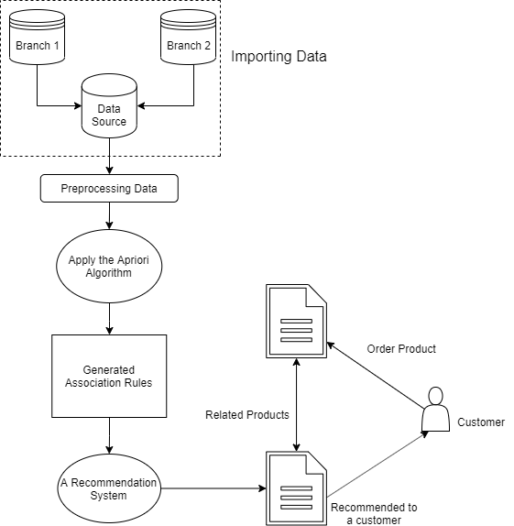
Project analysis slide 2
Methodology
System Overview
Importing Data
Preprocessing Data
Apply the Apriori Algorithm
Generated Association Rules

Slide 12
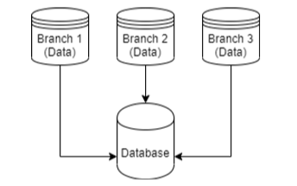
Project analysis slide 2
Methodology – Cont.
Importing Data
TID | Item
T1 | ESPRESSO
T1 | SUGAR
T1 | NEWSPAPER
T2 | ESPRESSO
T2 | SUGAR
T2 | COLA
… | …
Notes:
Collect customer purchase history data taken from any data source and import into relational database.
We need to match the data source column with our relational database formation column called target columns.
The source columns that provide must be the same size of target columns

Slide 13
Project analysis slide 2
Methodology – Cont.
Preprocessing Data
Converted historical transaction data into our algorithm formation.
Labeled the item as a number.
For example, ESPRESSO -> 1, SUGAR -> 2, NEWSPAPER -> 3 etc.
TID | Item | Item Label
T1 | ESPRESSO, SUGAR, NEWSPAPER | 1, 2, 3
T2 | ESPRESSO, SUGAR, COLA | 1, 2, 4
T3 | ESPRESSO, SUGAR | 1, 2
T4 | CAPPUCCINO, CIGARETTES | 5, 6
… | … | …

Slide 14
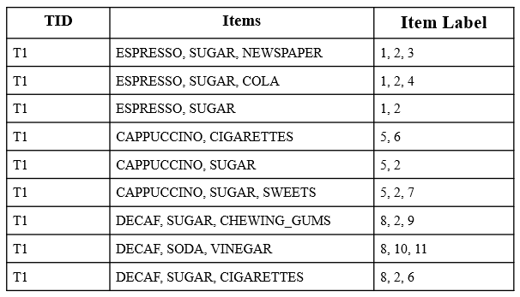
Project analysis slide 2
Methodology – Cont.
Apriori Algorithm
The example customer purchase histories.

Slide 15
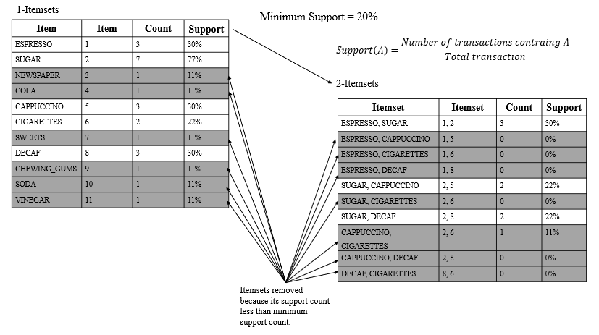
Project analysis slide 2
Methodology – Cont.
Apriori Algorithm – Cont.
The high level of frequent itemset generation for the Apriori.

Slide 16
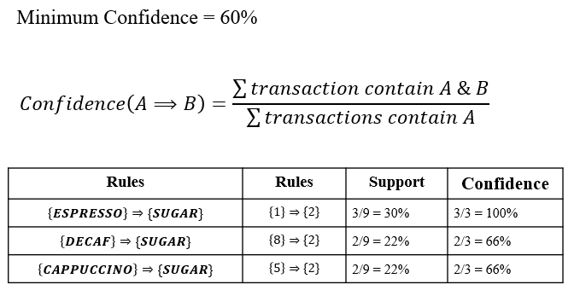
Project analysis slide 2
Methodology – Cont.
Association Rule Generation

Slide 17
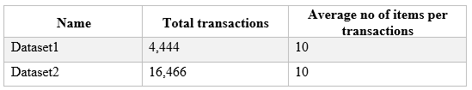
Project analysis slide 2
Experiments
Environmental Setup
Processor: Intel(R) Core (TM) i5-5200U CPU @ 2.20GHz, 2201Mhz, 2 Core(s), 4 Logical Processor(s).
RAM: 16.00 GB
Datasets
Notes:
Stemming work by slicing the end or the beginning of the word, using a list of common prefixes and suffixes like (-ing, -ed, -es). This slicing can be successful on most occasions, but not always.

Slide 18
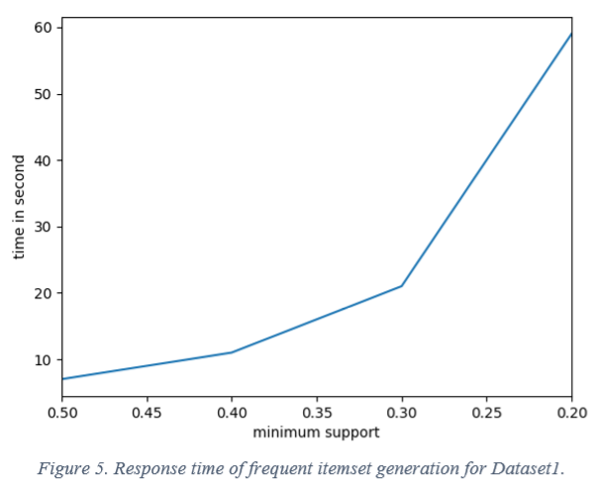
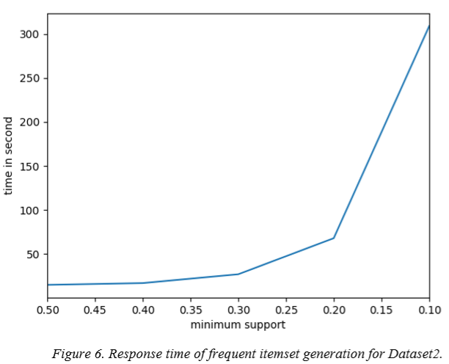
Project analysis slide 2
Experiments – Cont.
Results
Notes:
We used datasets that contains 4,444 and 16,466 transactions. The average number of items contained in a transaction is 10, while the variance is ± 7 items. The graph in Figure 5 and Figure 6 illustrates the performance of our implementation in means of response time (seconds) while the minimum support threshold varies from 0.5% down to 0.1%. We observe that while the minimum support decreases, the response time of the algorithm increases. This is expected, since lower values of minimum support result more frequent itemsets to be discovered and consequently more possible extensions.

Slide 19
Project analysis slide 2
Conclusions &
Future Works
Conclusions
Proposed an architecture for association item analysis for RSs.
Developed and conducted experiment of RS by using Association Analysis Apriori Algorithm.
The results can provide recommended a new item to customers by understanding historical transaction data.
Future Works
Make a library for recommend product to customers by using association items from our proposed frameworks.

Slide 20
Thank You

